Slide 1
15: Smoothing

Slide 2
Smoothing Surfaces
Many techniques lead to rough surfaces
We want the equivalent of image filters
Blur
Or surfaces that are too smooth already
Sharpen
Or add detail (bump maps, &c.)
So what does it mean to smooth a surface?

Slide 3
Meaning of Smoothing
To reduce high-frequency information
I.e. rapid changes in surface
Reduce the curvature (aha!)
Related to simplification
But retains the triangle count

Slide 4
Example
Laser scan has measurement noise
We want to get rid of it
Colour-coding is mean curvature

Slide 5
A Warning
Sometimes you want sharp edges
Eg machined surfaces
There are many techniques for retaining them
NURBS in particular
Some variants of subdivision surfaces
But we will ignore this

Slide 6
Image Filtering
We introduced Fourier analysis for filtering
Breaks a function into sums of sines / cosines
High frequency – sharp detail
Low frequency – blurring, large features
We did it for 1D & 2D
Of course it works for 3D (volumetric)
But we now have a 2-manifold surface

Slide 7
Spherical Harmonics
Define a set of radial patterns on a sphere
Different frequencies & amplitudes
Break the surface function into them
Works best for roughly spherical shapes
Less well for arbitrary manifolds

Slide 8
Manifold Harmonics
Based on observation about Fourier analysis
Sines / cosines are eigenfunctions
Of the Laplace operator of the function
So we use the Laplace-Beltrami of the position
It’s a symmetric positive semi-definite matrix
Find it’s eigenvectors
Use these to decompose the function

Slide 9
Manifold Harmonics
Basis functions emphasise different regions

Slide 10
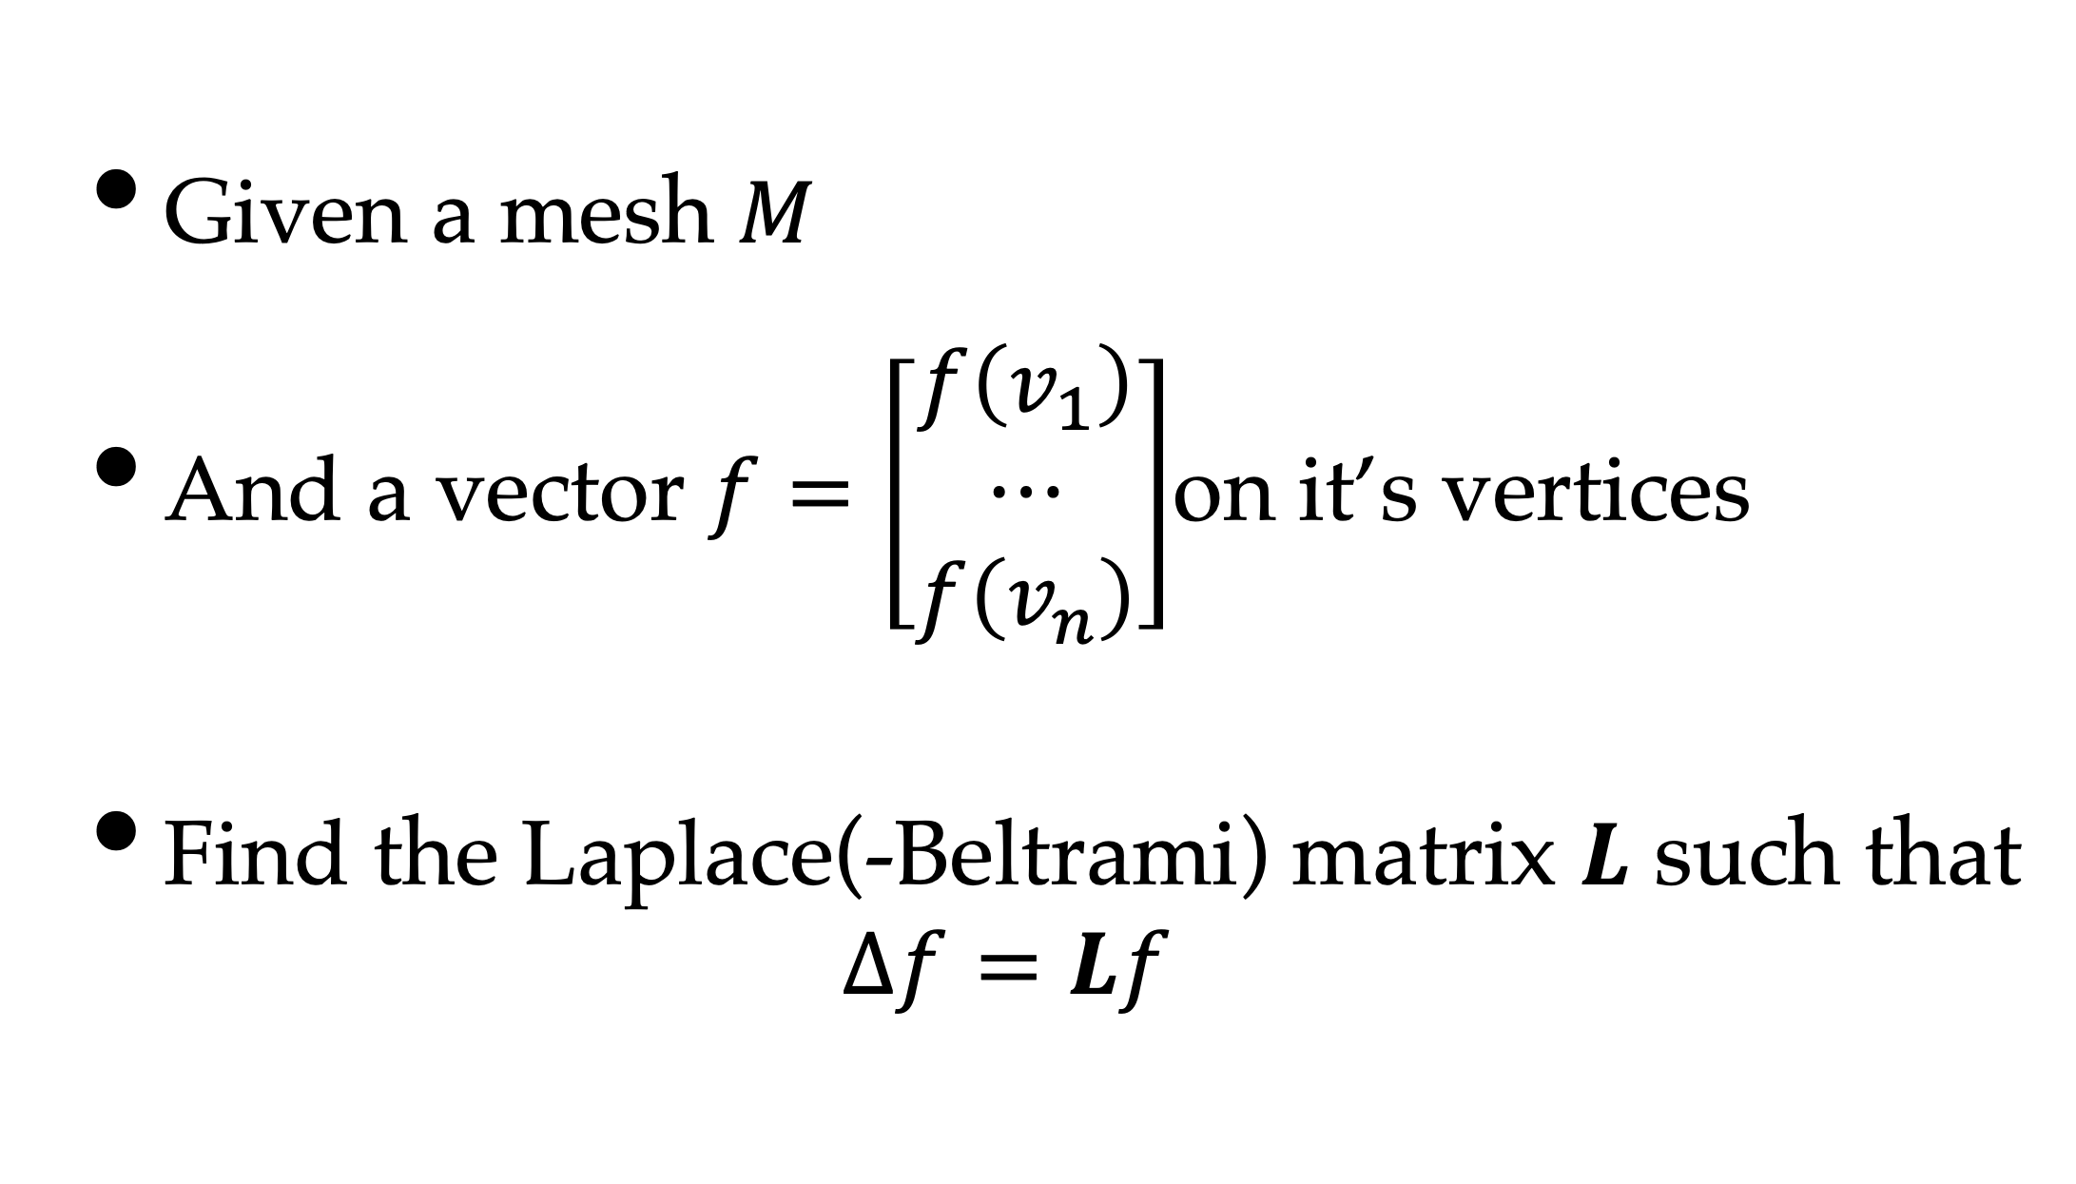
Laplace-Beltrami Matrix
Given a mesh $M$
And a vector $f=\left[\begin{matrix}f\left(v_{1}\right) \\ ⋯ \\ f\left(v_{n}\right)\end{matrix}\right]$on it’s vertices
Find the Laplace(-Beltrami) matrix $L$ such that
$$∆f=Lf$$

Slide 11
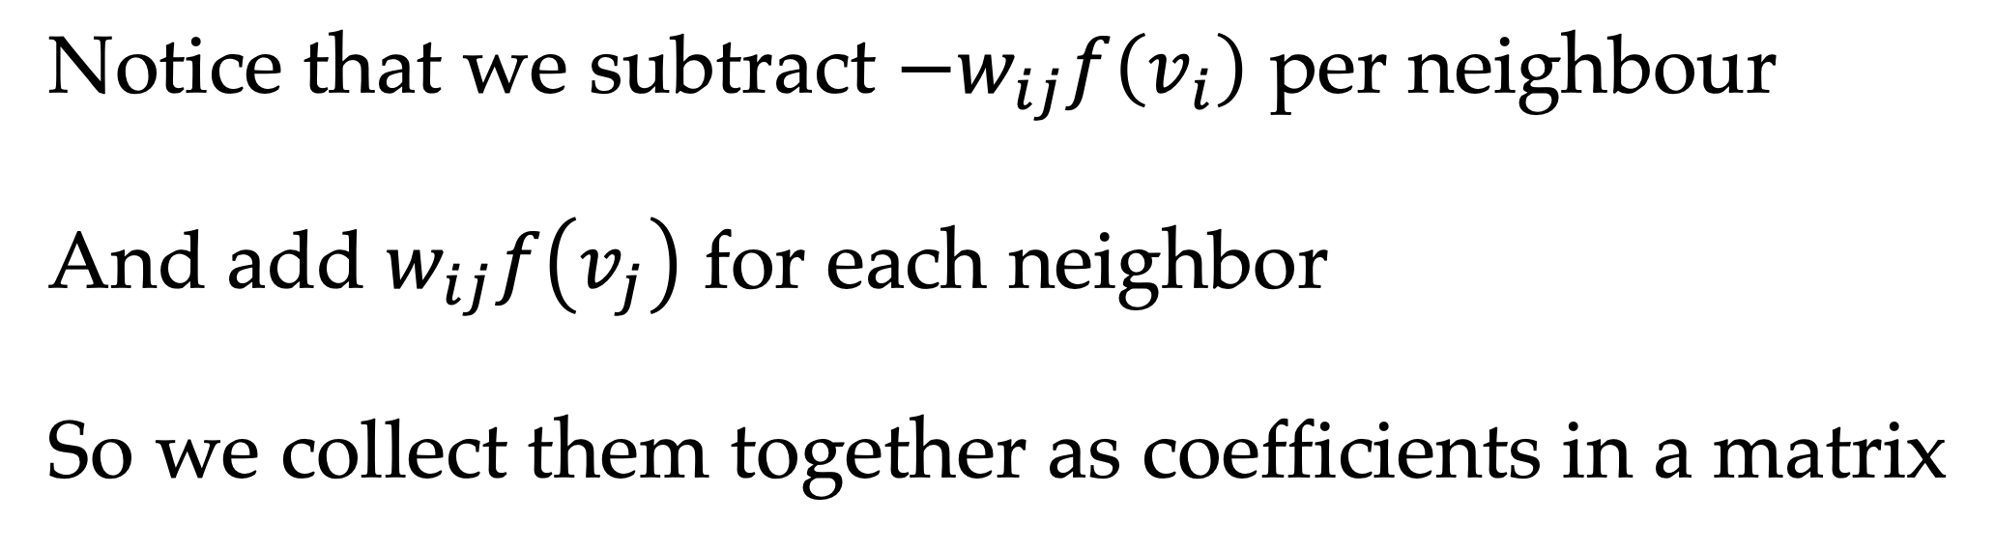
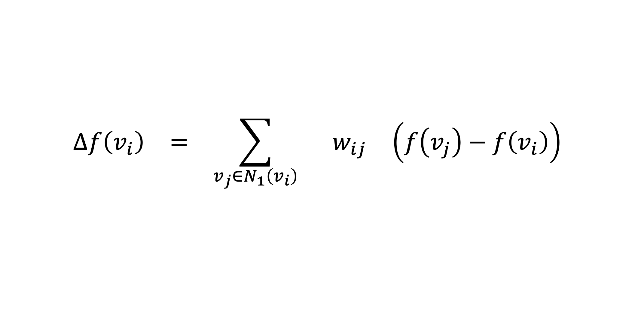
L-B Development
$$\begin{matrix}∆f\left(v_{i}\right) & = & \sum_{v_{j}∈N_{1}\left(v_{i}\right)}^{ }{ } & w_{ij} & \left(f\left(v_{j}\right)−f\left(v_{i}\right)\right) \\ & & & & \\ & & & & \end{matrix}$$
Vertex value (position)
Sum on 1-ring
Weight
Value difference (edge vector)
Notice that we subtract $−w_{ij}f\left(v_{i}\right)$ per neighbour
And add $w_{ij}f\left(v_{j}\right)$ for each neighbor
So we collect them together as coefficients in a matrix

Slide 12
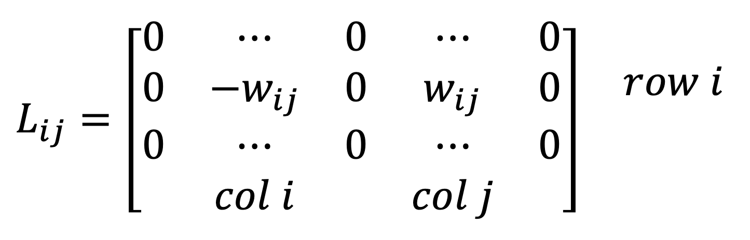
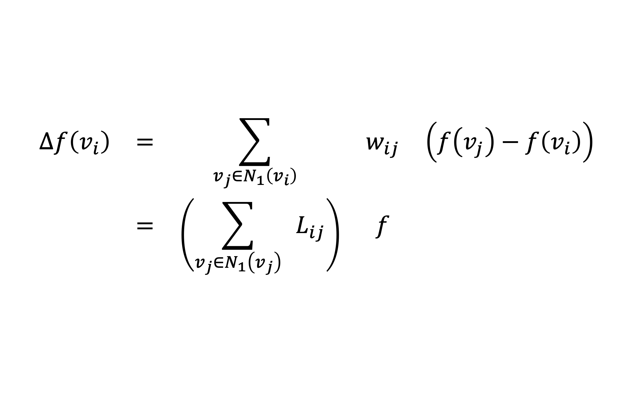
L-B Development
$$\begin{matrix}∆f\left(v_{i}\right) & = & \sum_{v_{j}∈N_{1}\left(v_{i}\right)}^{ }{ } & w_{ij} & \left(f\left(v_{j}\right)−f\left(v_{i}\right)\right) \\ & = & \left(\sum_{v_{j}∈N_{1}\left(v_{j}\right)}^{ }{ }L_{ij}\right) & f & \\ & & & & \end{matrix}$$
$$L_{ij}=\begin{matrix}\left[\begin{matrix}0 & ⋯ & 0 & ⋯ & 0 \\ 0 & −w_{ij} & 0 & w_{ij} & 0 \\ 0 & ⋯ & 0 & ⋯ & 0 \\ & col i & & col j & \end{matrix}\right] & \begin{matrix} \\ row i \\ \\ \end{matrix}\end{matrix}$$

Slide 13
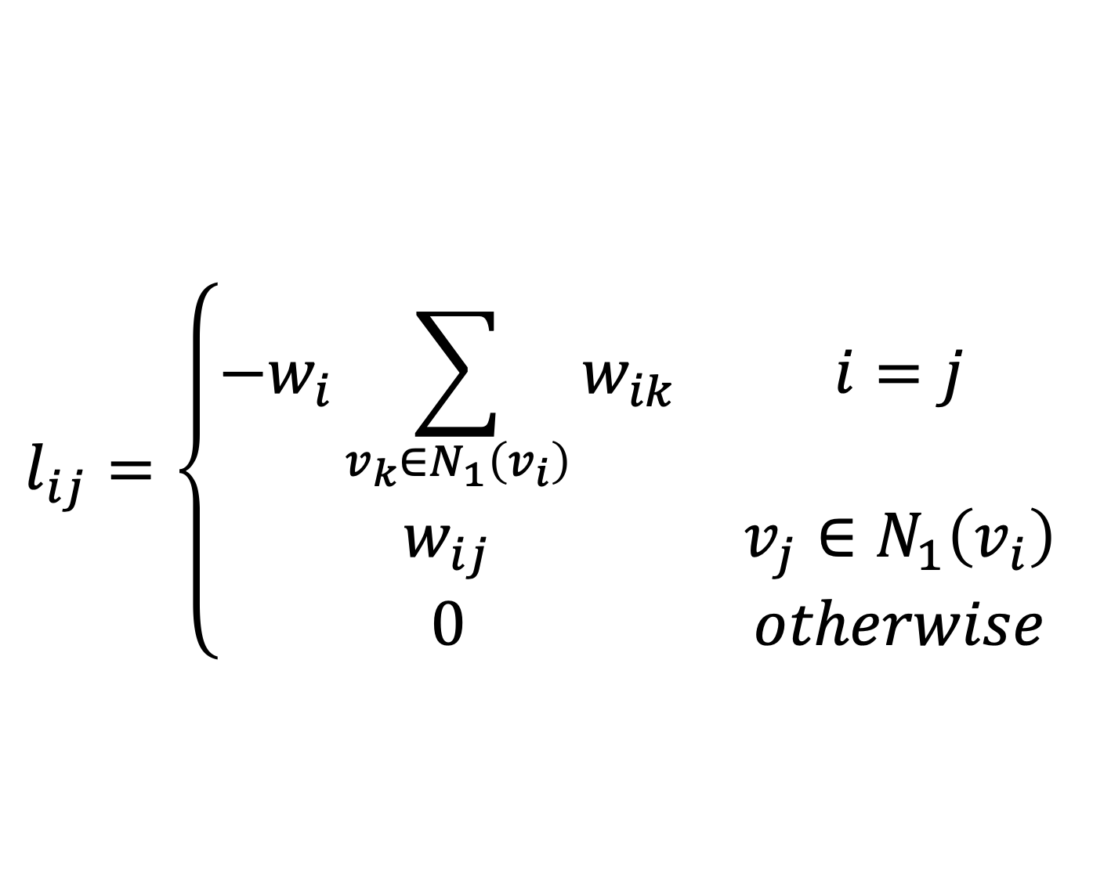

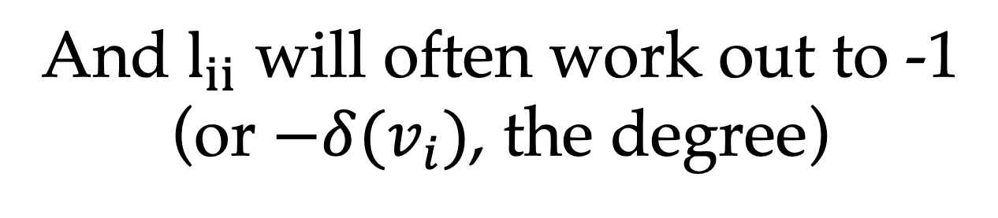
L-B Development
$$\begin{matrix} ∆f\left(v_{i}\right) & = & L & f \\ & & & \\ & & & \end{matrix}$$
where
$$l_{ij}=\left\{\begin{matrix}−w_{i}\sum_{v_{k}∈N_{1}\left(v_{i}\right)}{w_{ik}} & i=j \\ w_{ij} & v_{j}∈N_{1}\left(v_{i}\right) \\ 0 & otherwise\end{matrix}\right.$$
And $l_{ii}$ will often work out to -1
(or $−δ(v_{i})$, the degree)

Slide 14
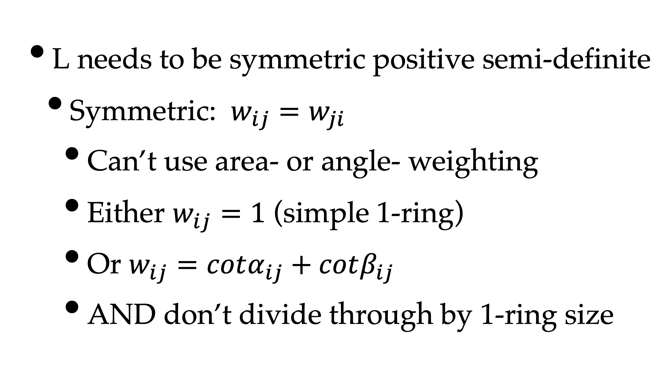
Constraints
L needs to be symmetric positive semi-definite
Symmetric: $w_{ij}=w_{ji}$
Can’t use area- or angle- weighting
Either $w_{ij}=1$ (simple 1-ring)
Or $w_{ij}=cotα_{ij}+cotβ_{ij}$
AND don’t divide through by 1-ring size

Slide 15
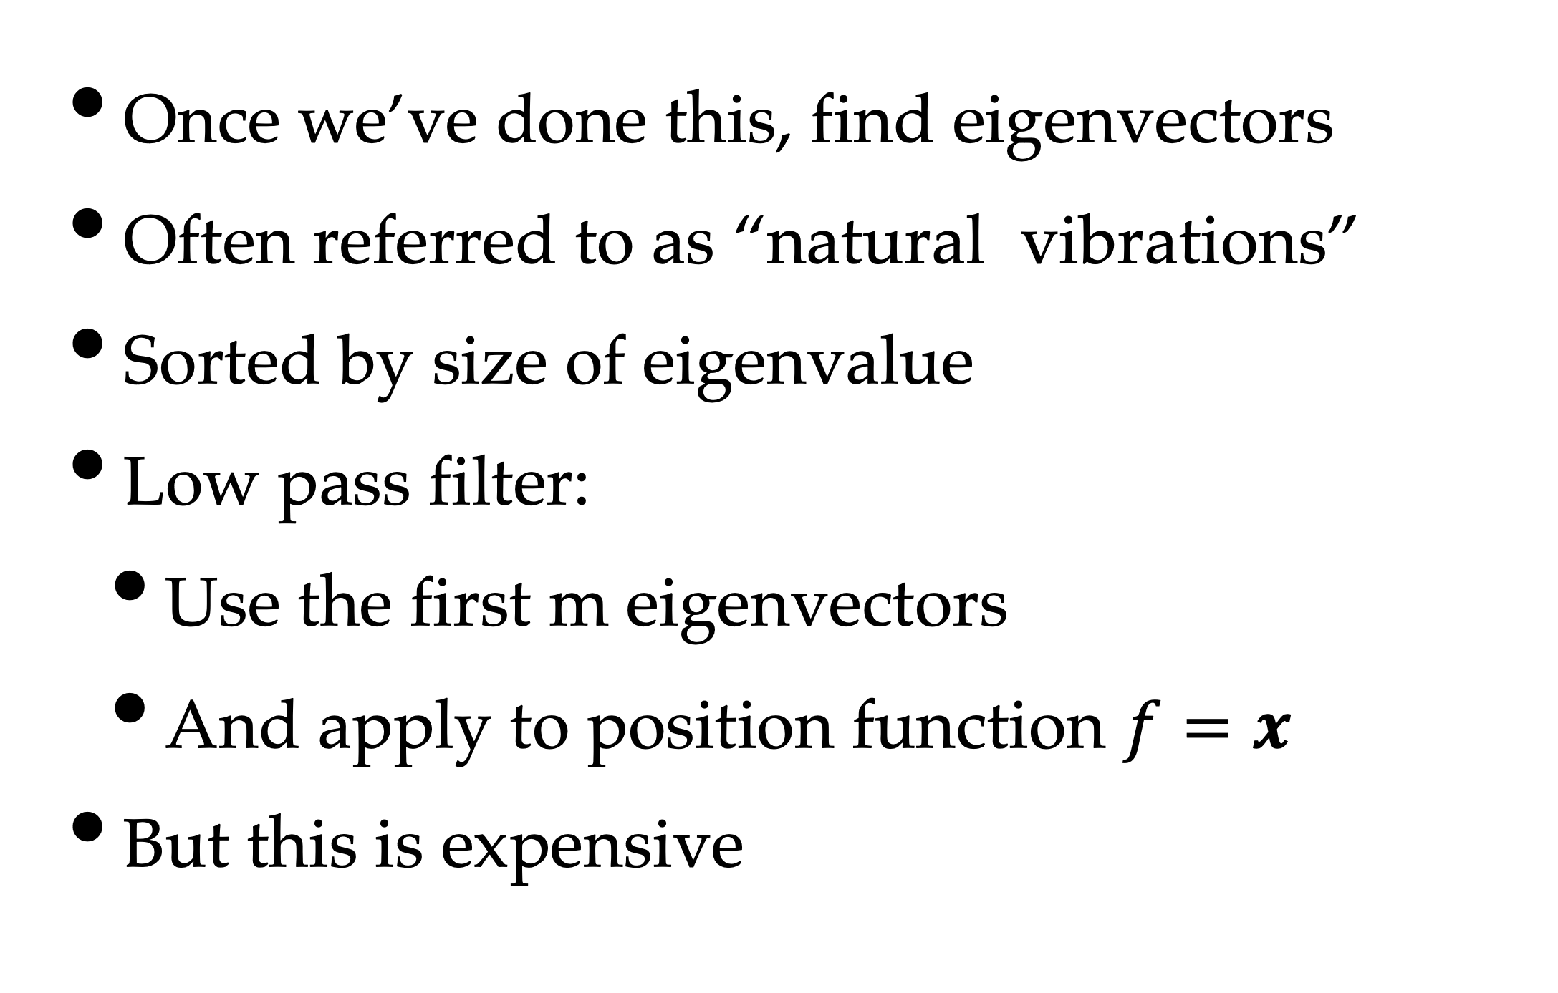
Processing
Once we’ve done this, find eigenvectors
Often referred to as “natural vibrations”
Sorted by size of eigenvalue
Low pass filter:
Use the first m eigenvectors
And apply to position function $f=x$
But this is expensive

Slide 16
First M Harmonics
First harmonics define shape
Later harmonics define details
But you can have a lot of them

Slide 17
Results
Model
Low
Pass
High
Pass
Enhancement
General filters weight all harmonics
Preserving at least some detail from each

Slide 18
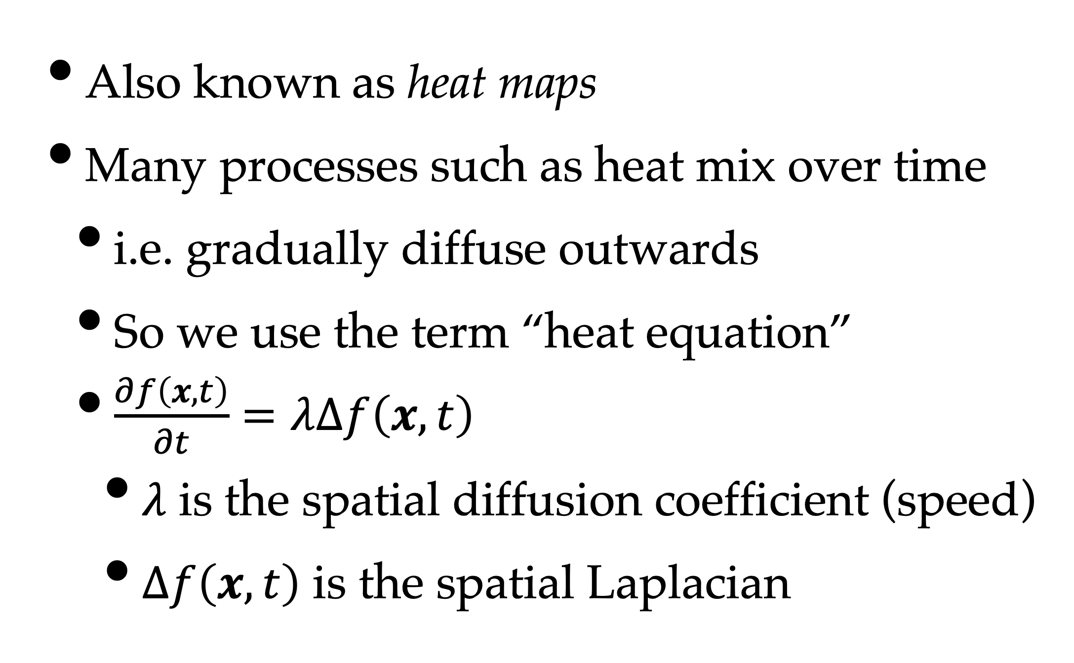
Diffusion Flow
Also known as heat maps
Many processes such as heat mix over time
i.e. gradually diffuse outwards
So we use the term “heat equation”
$\frac{∂f\left(x,t\right)}{∂t}=λ∆f\left(x,t\right)$
$λ$ is the spatial diffusion coefficient (speed)
$∆f\left(x,t\right)$ is the spatial Laplacian

Slide 19
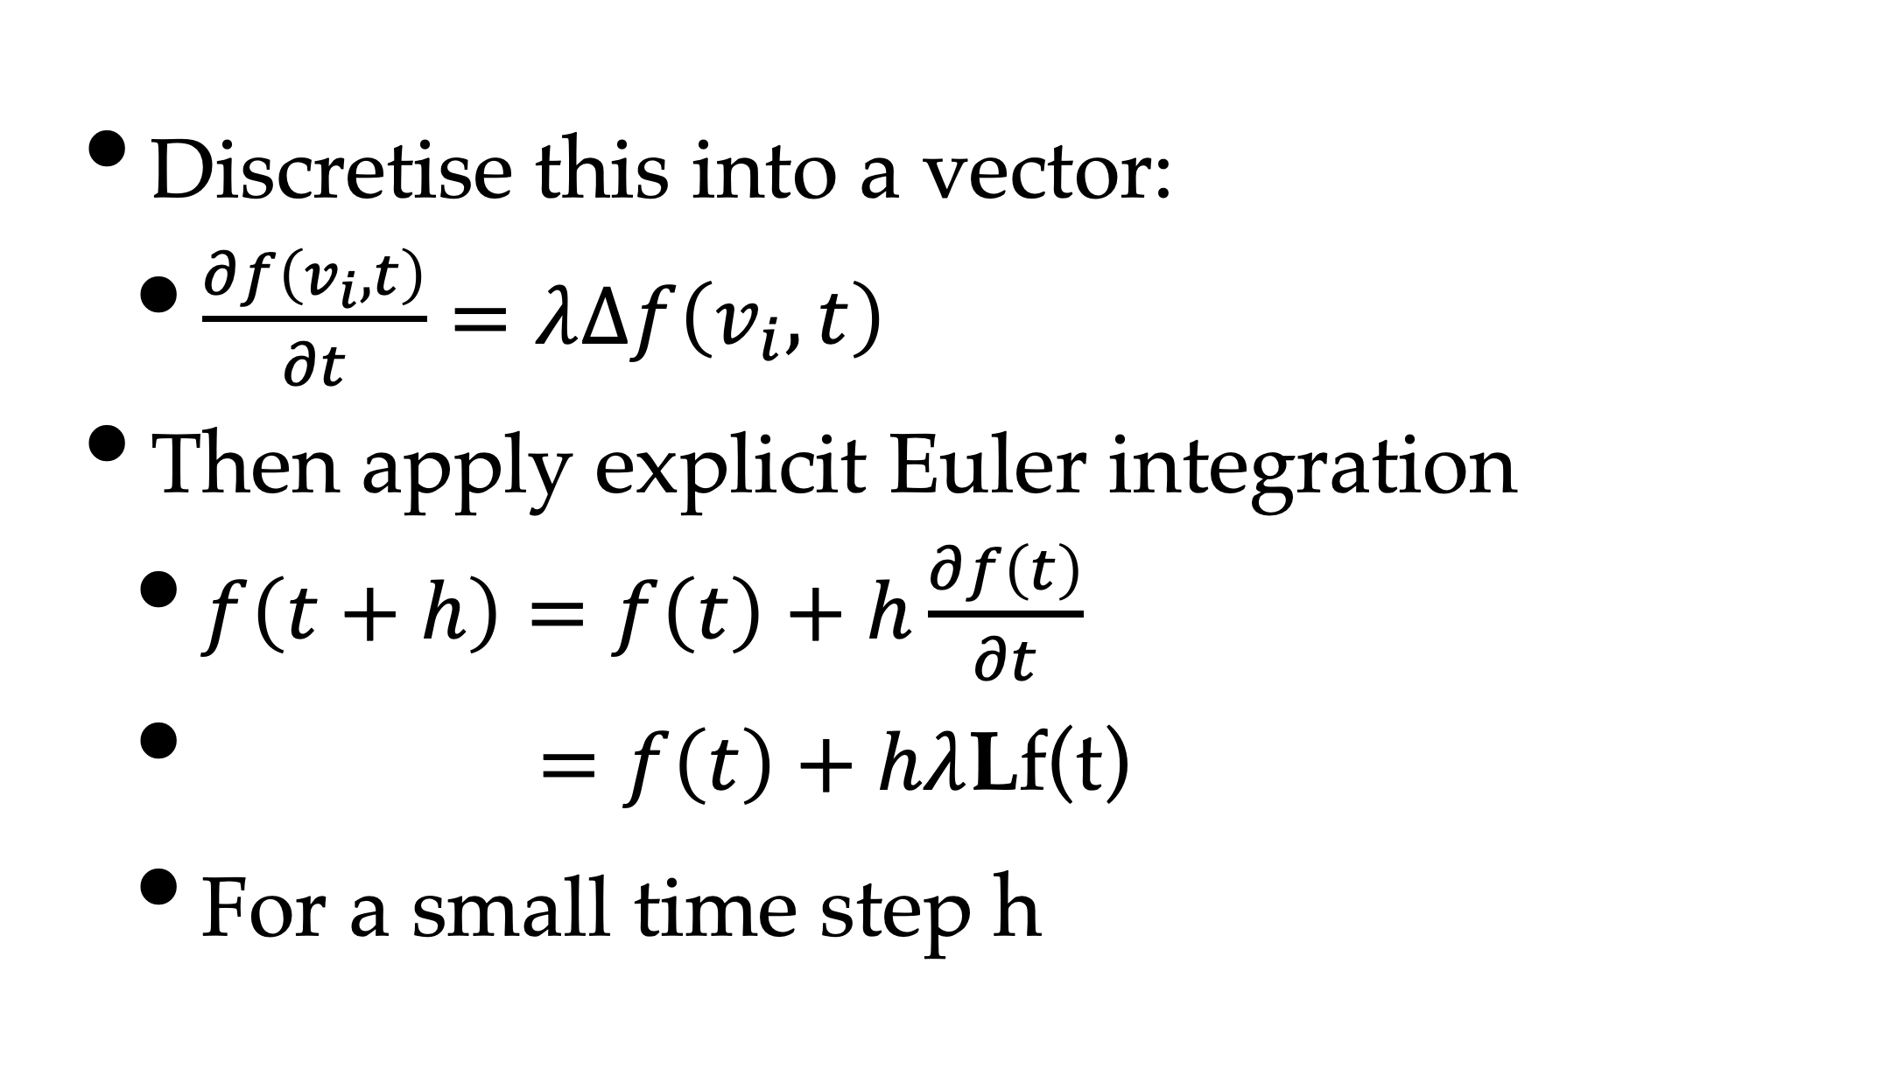
Discretisation & Integration
Discretise this into a vector:
$\frac{∂f\left(v_{i},t\right)}{∂t}=λ∆f\left(v_{i},t\right)$
Then apply explicit Euler integration
$f\left(t+h\right)=f\left(t\right)+h\frac{∂f\left(t\right)}{∂t}$
$=f\left(t\right)+hλ$Lf(t)
For a small time step h

Slide 20
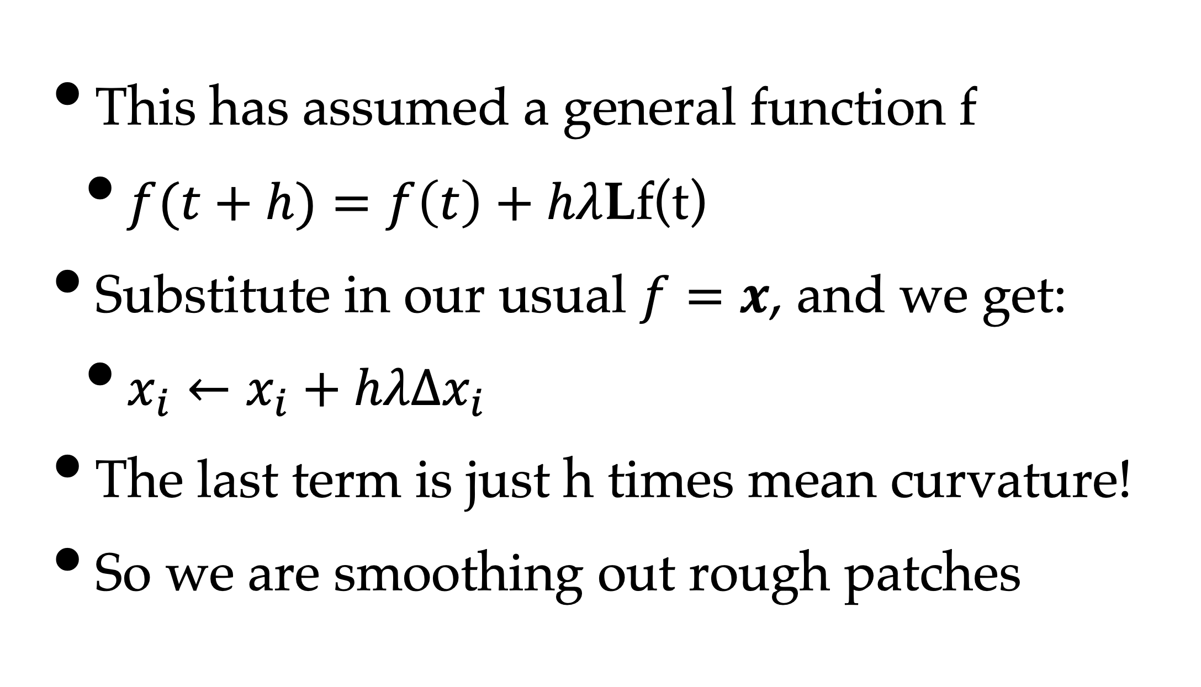
Spatial Position
This has assumed a general function f
$f(t+h)=f\left(t\right)+hλ$Lf(t)
Substitute in our usual $f=x$, and we get:
$x_{i}←x_{i}+hλΔx_{i}$
The last term is just h times mean curvature!
So we are smoothing out rough patches

Slide 21
Curvature Flow Smoothing
After 0, 10 and 100 iterations

Slide 22
Variations
Original
Uniform: 10
Cotangent: 10
If you weight the 1-ring uniformly
Vertex moves towards neighbours’ centroid
And it tends to regularize the triangles
Cotangent weights preserve triangle shapes

